Slide 1
Object-Oriented Programming (OOP) Basics in Python
An Introduction to Classes, Objects, and Core Concepts

Slide 2
What is OOP?
OOP stands for Object-Oriented Programming
Focuses on "objects" that encapsulate data and behavior
Encourages:
- Code reusability
- Modularity
- Maintainability

Slide 3
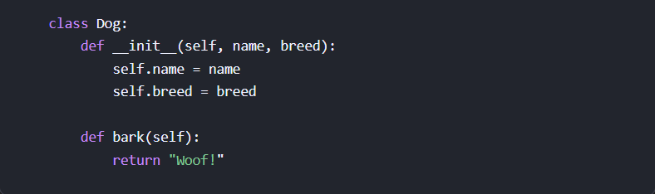
Classes
Blueprints for creating objects.
Define the attributes and methods that objects of that class will have.
Example:

Slide 4
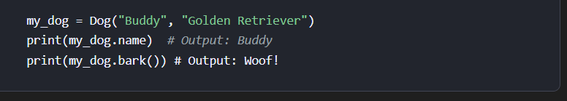
Objects
Instances of classes.
Represent real-world entities or concepts.
Example:

Slide 5
Encapsulation
Bundles data and methods inside a class
Restricts external access to data
Access Modifiers:
- Public: self.name
- Protected: self._name
- Private: self.__name

Slide 6
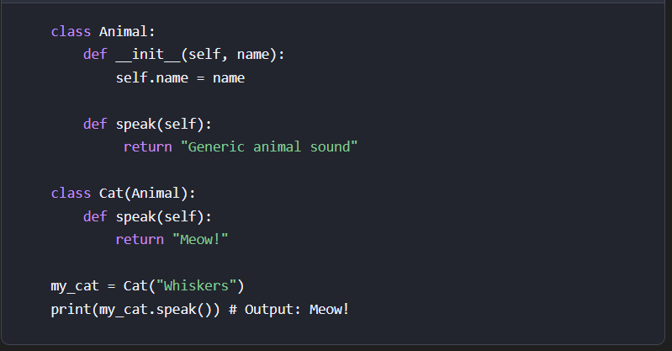
Inheritance
Let me explain with an example:
class Animal: def __init__(self, name): self.name = name def speak(self): return "Generic animal sound" class Cat(Animal): def speak(self): return "Meow!" my_cat = Cat("Whiskers") print(my_cat.speak()) # Meow!

Slide 7
Polymorphism
Different classes respond differently to the same method
Achieved through method overriding
Allows flexibility and extensibility

Slide 8
Abstraction
Hides complex details, shows only essentials
Achieved via abstract classes (abc module)
Simplifies usage and maintenance

Slide 9
Benefits of OOP
✅ Code Reusability
✅ Modularity & Maintainability
✅ Data Protection
✅ Flexibility through Polymorphism
✅ Real-World Modeling

Slide 10
Summary
OOP is a powerful paradigm for organizing and managing code
Python supports all major OOP principles:
- Classes
- Objects
- Encapsulation
- Inheritance
- Polymorphism
- Abstraction

Slide 11
Thank You!
Questions?

